Slide 1

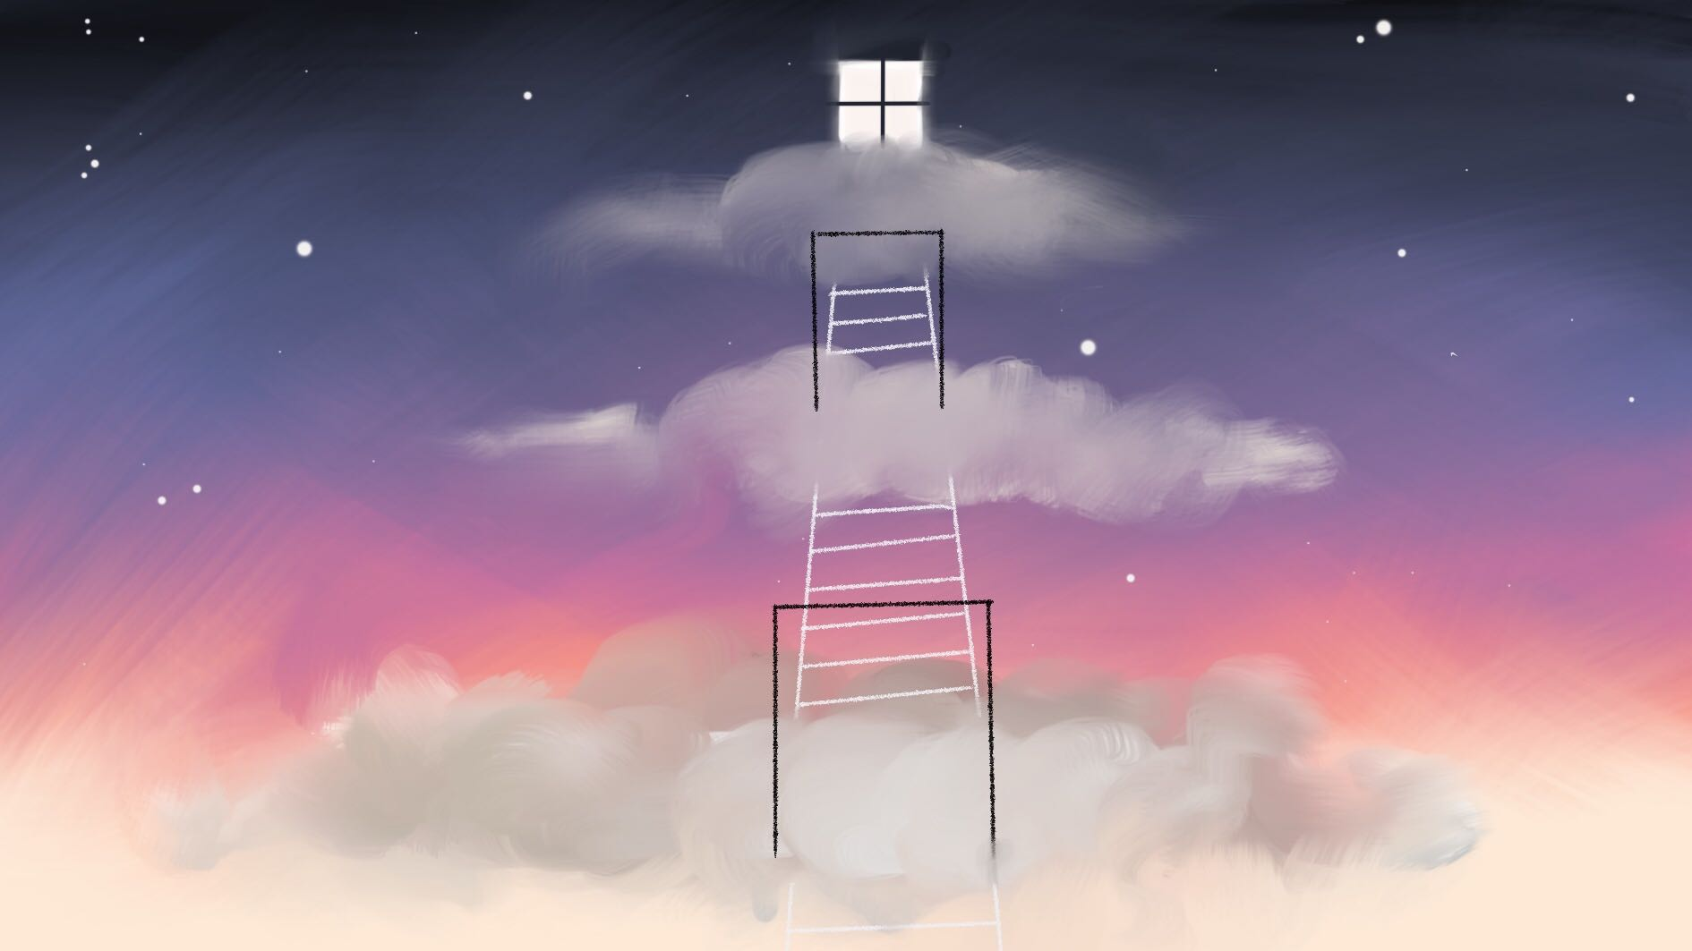
WHAT BECOMES OF THE BROKEN HEARTED?
- Project Heart -
Collaborative project. Narrative Game. ST_2019

Slide 2
TEAM PROJECT HEART
IGNACIO
Writer & Designer
ALBA
Project Lead & Character Artist
FREDERYK
Programmer,
VFX & Music
MARIA
Environment Artist

Slide 3
GAME CONCEPT

Slide 4
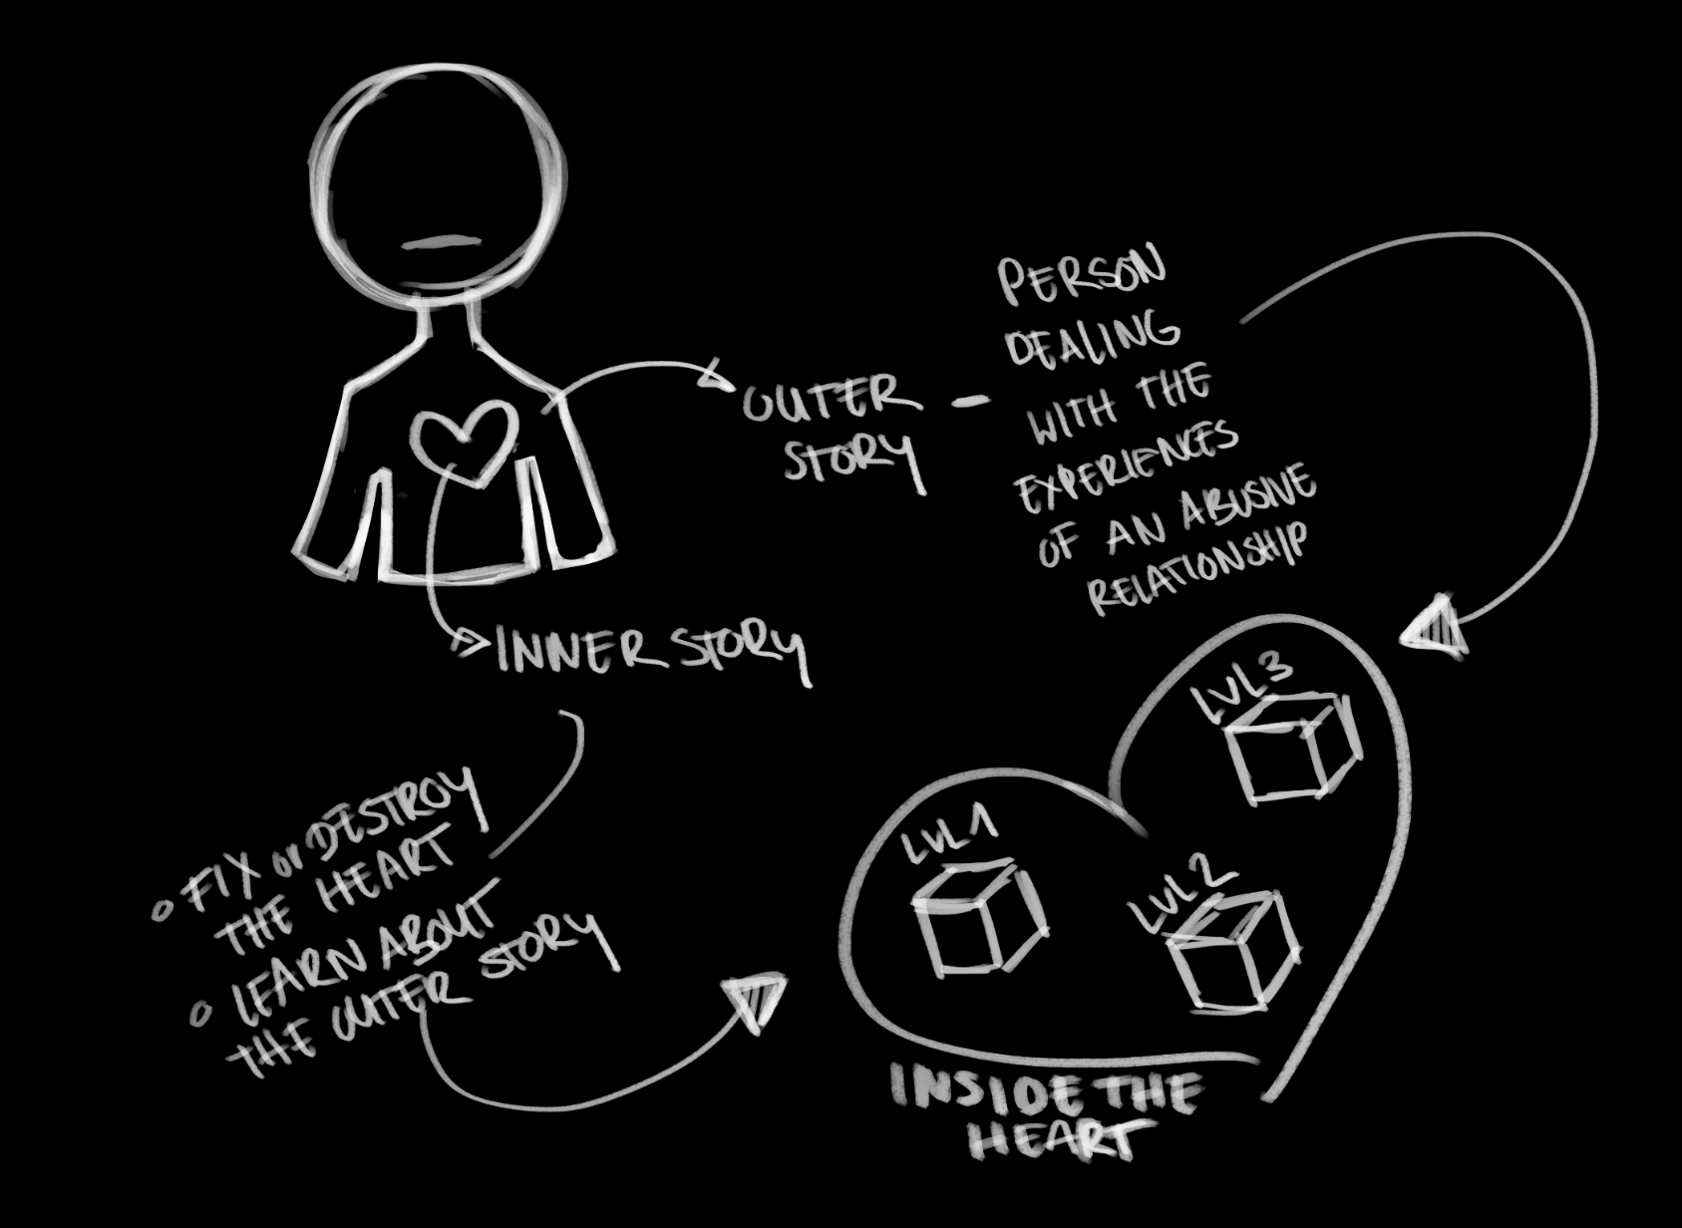
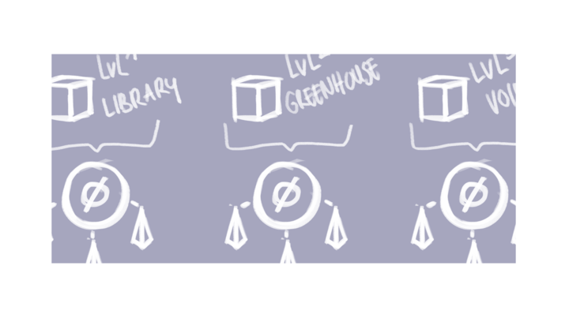
THE STORY

Slide 5
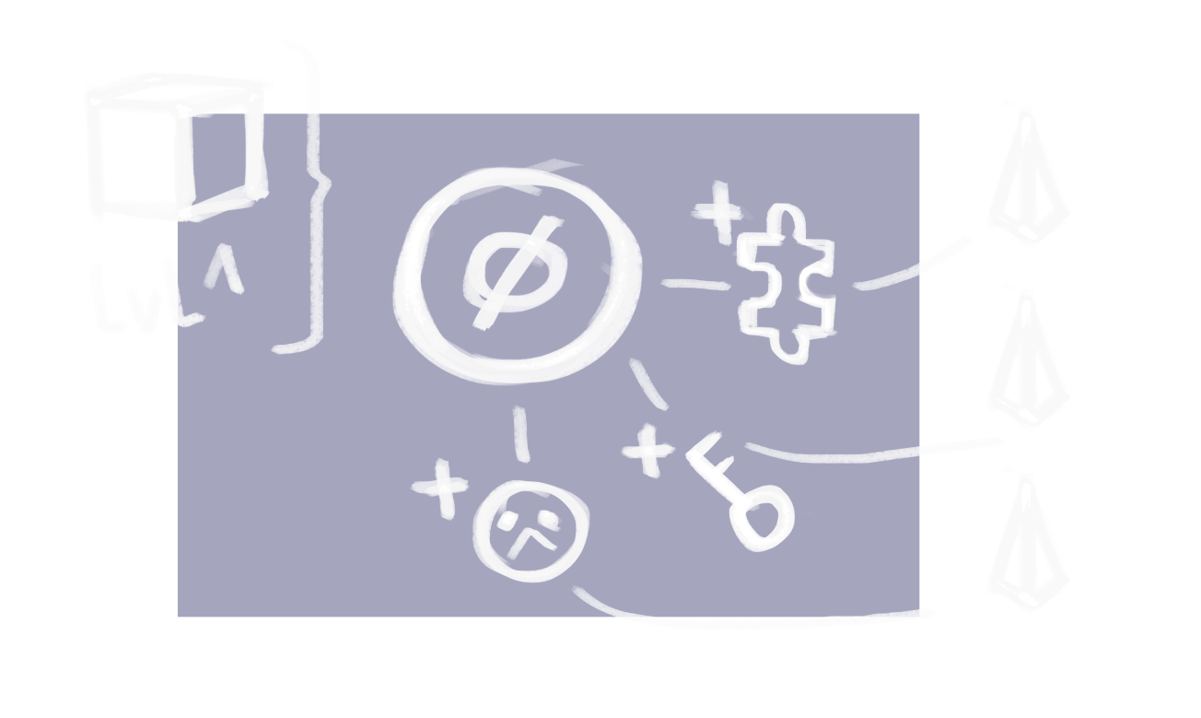
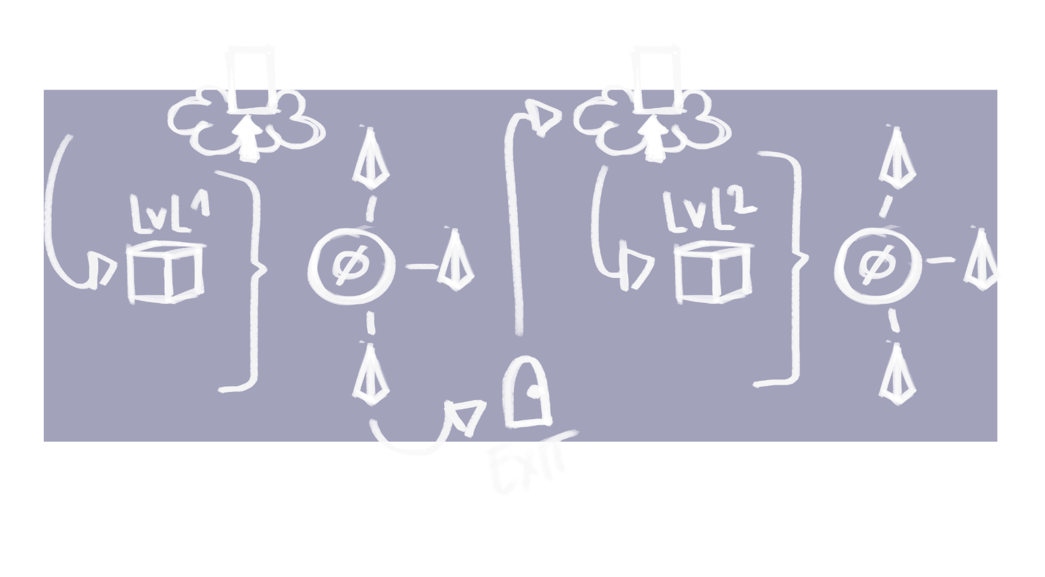
INSIDE A LEVEL
GAMEPLAY LOOP

Slide 6


THE EMOTIONS

Slide 7
Middle
Calm
Dark
Shift in tone,
unsettling
Beginning
Ending

Slide 8
ARTWORK

Slide 9
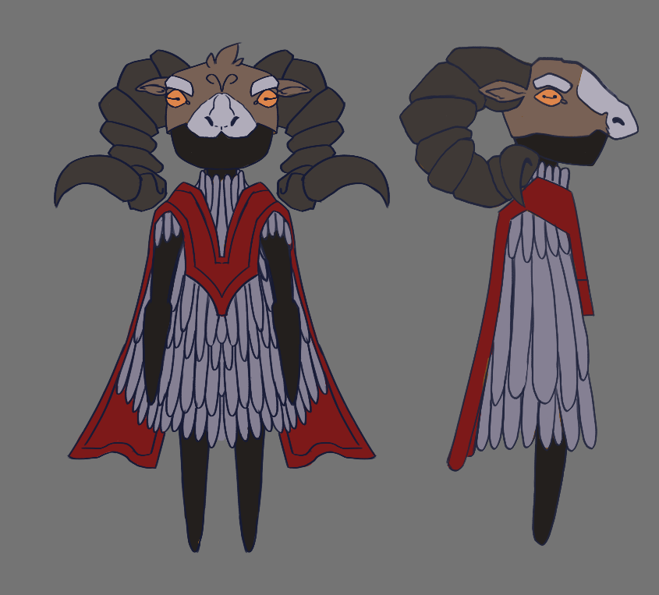
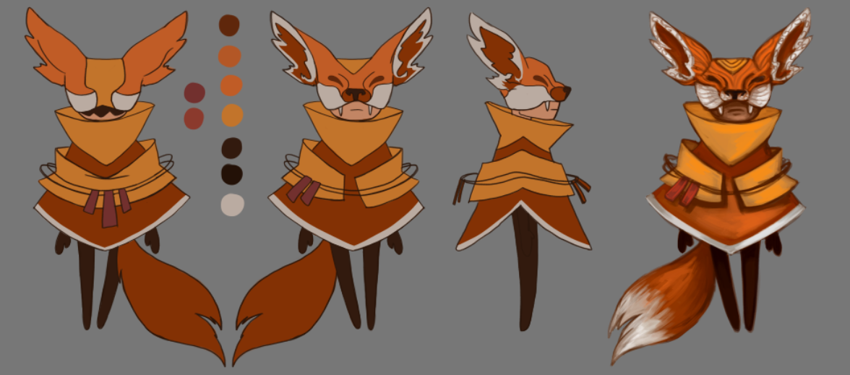
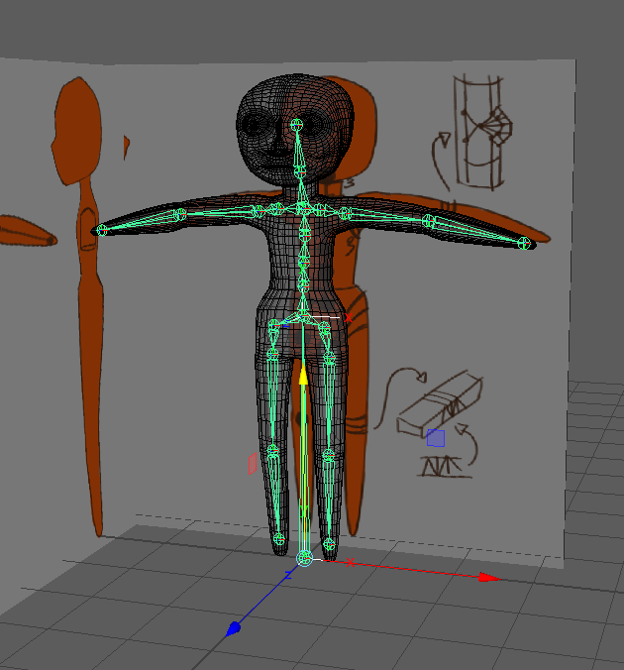
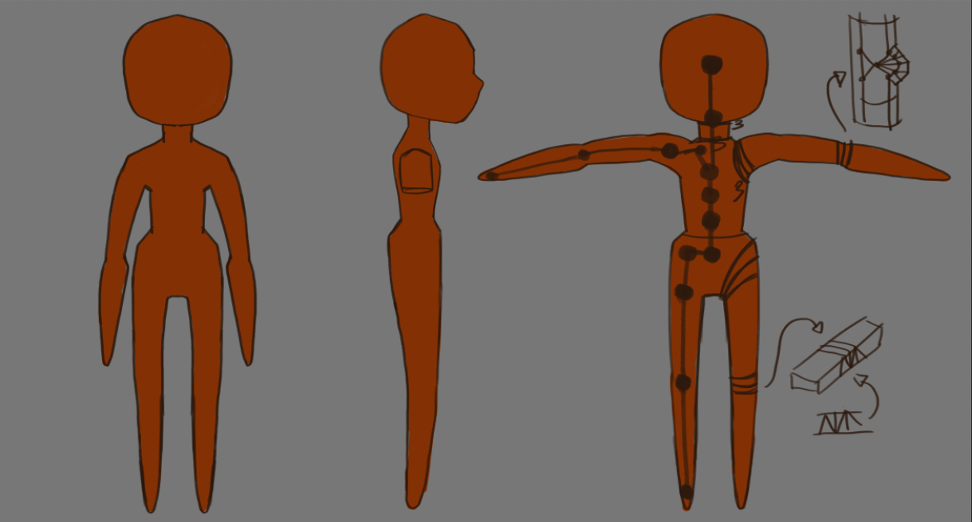
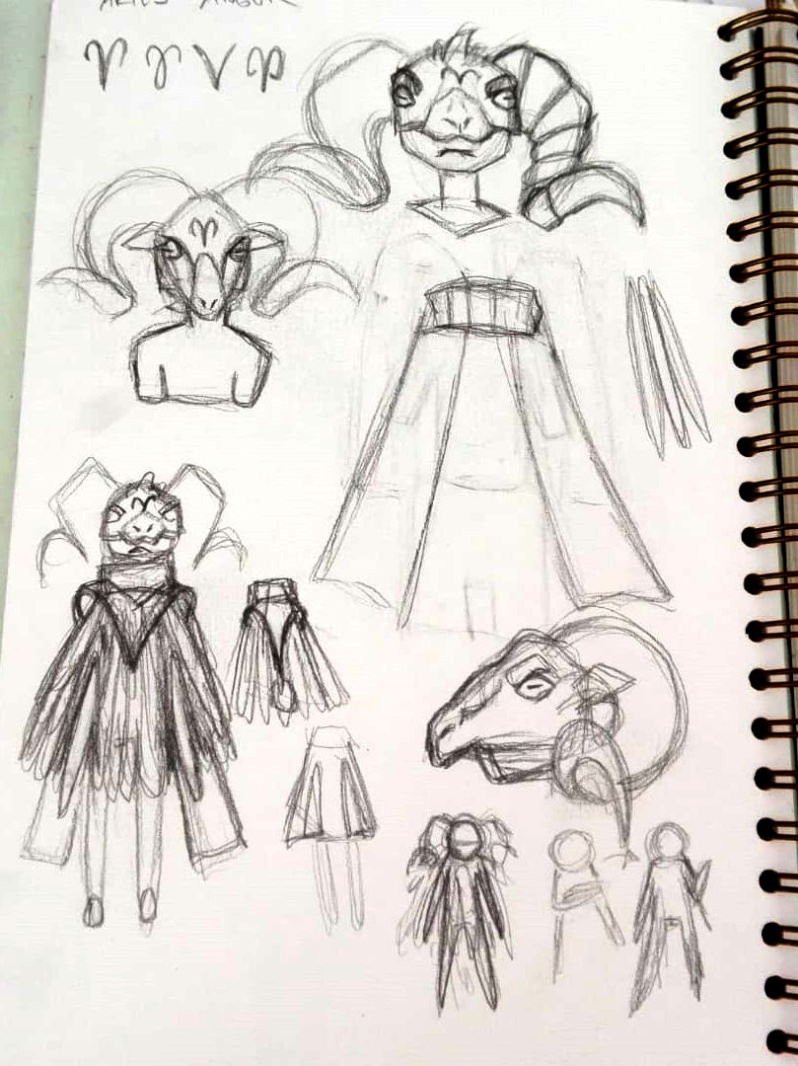
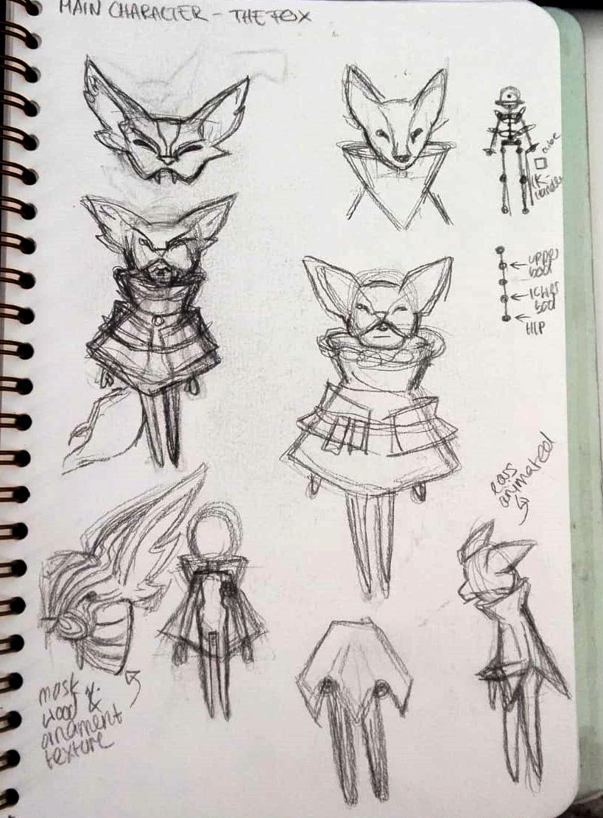
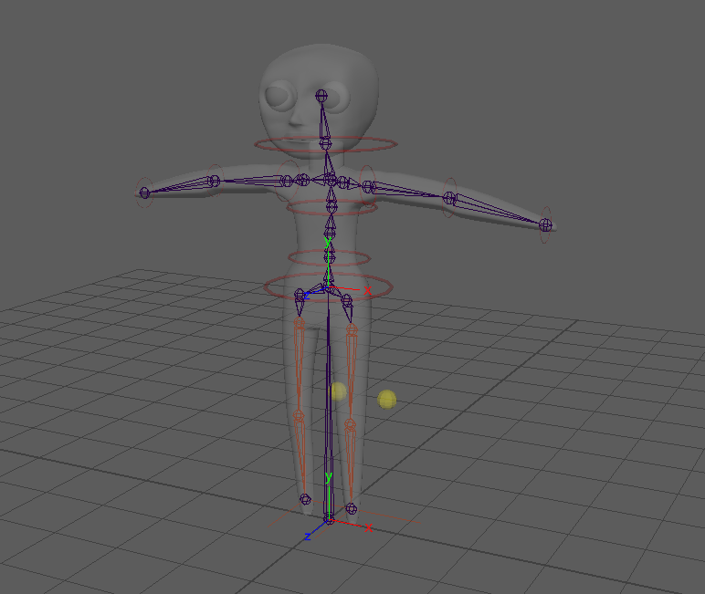
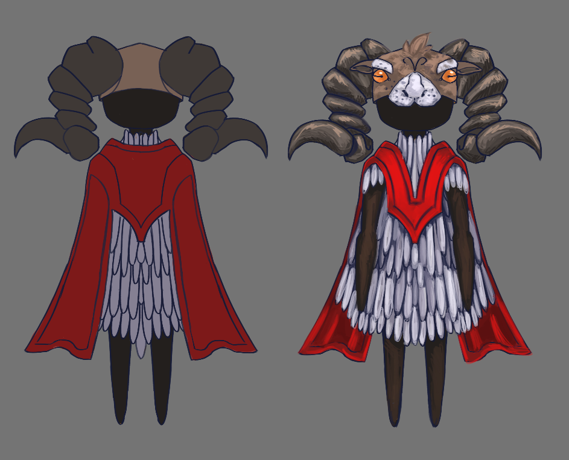
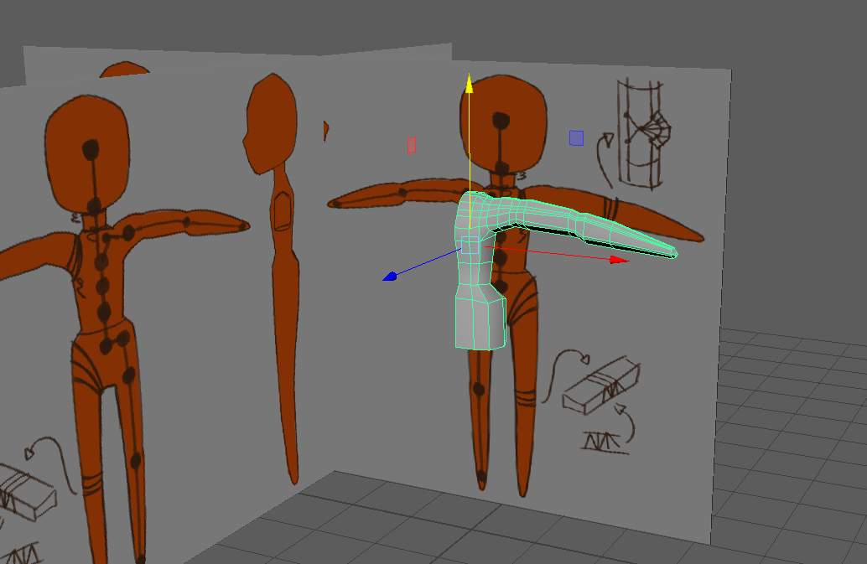
Anger Concept
3D Model
Sketches of Characters
A
B
The Protagonist Concept
C
D
~ Character Concept Art ~
Alba
F

Slide 10
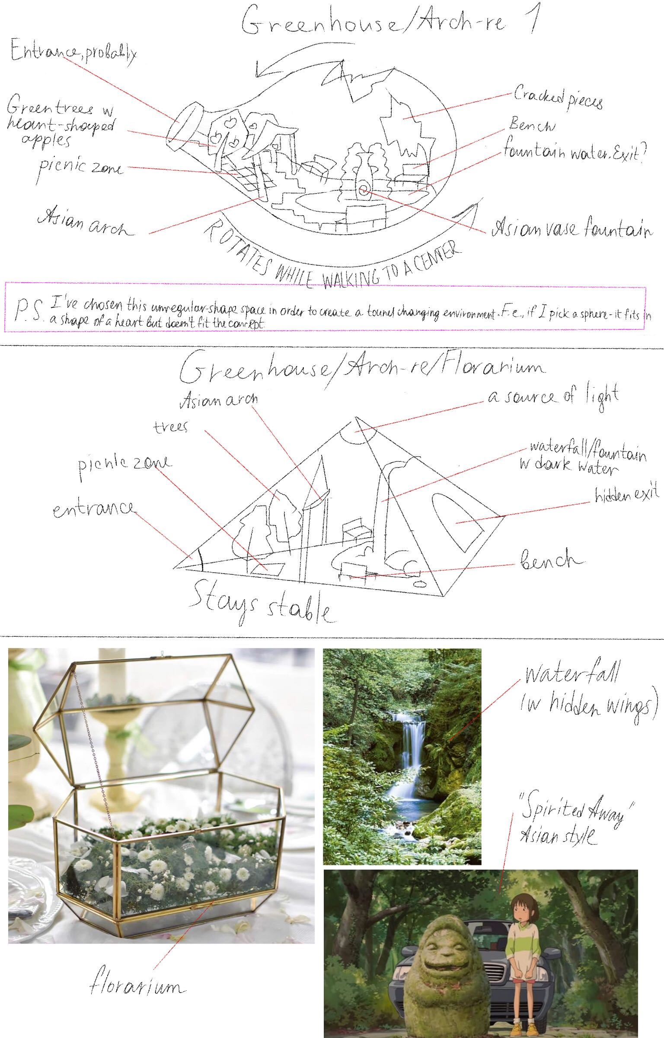
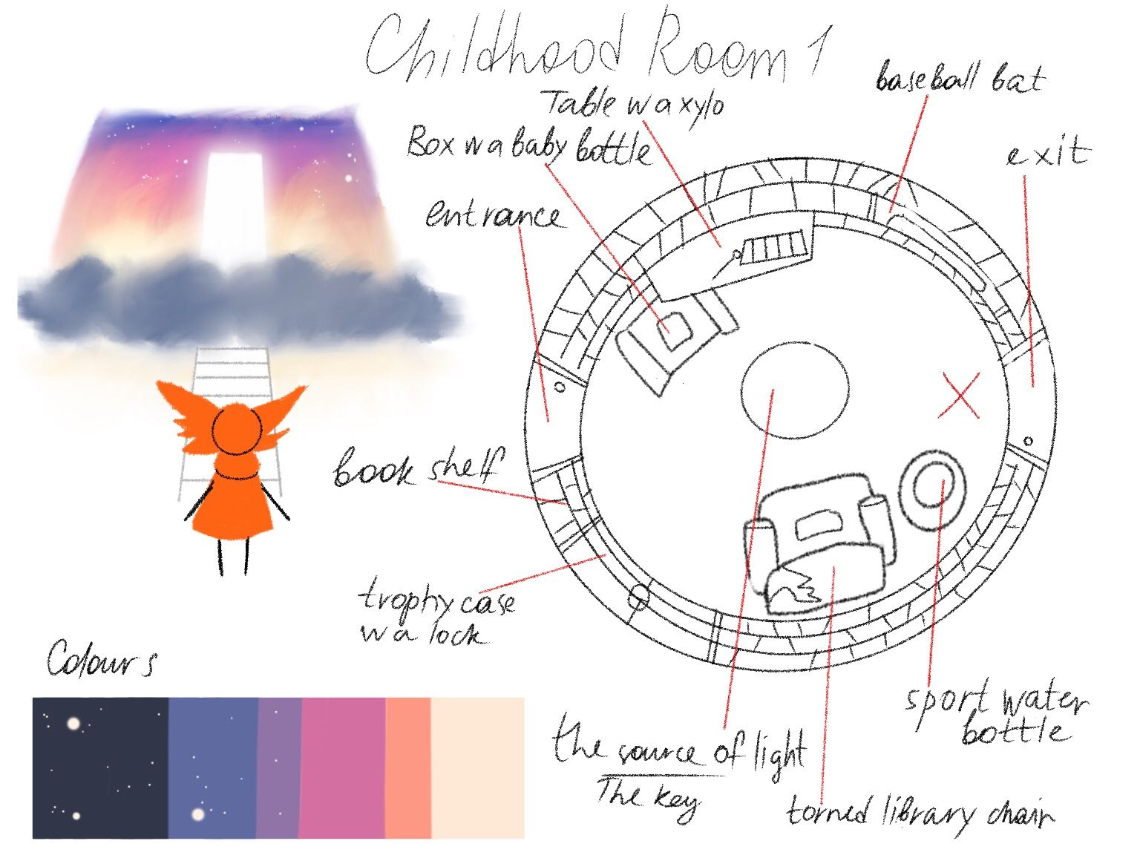
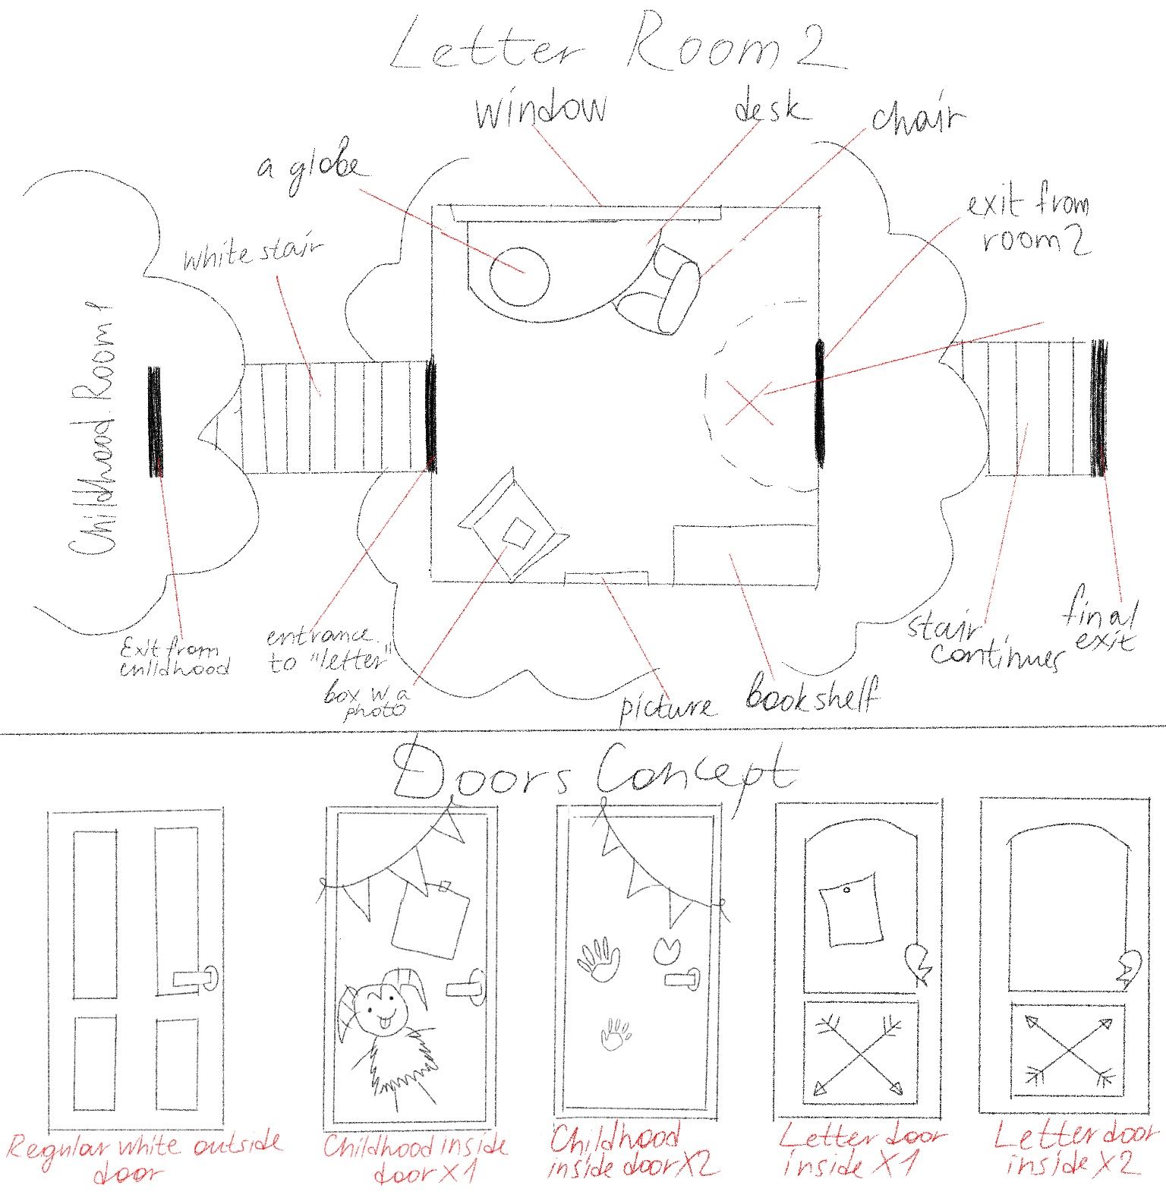
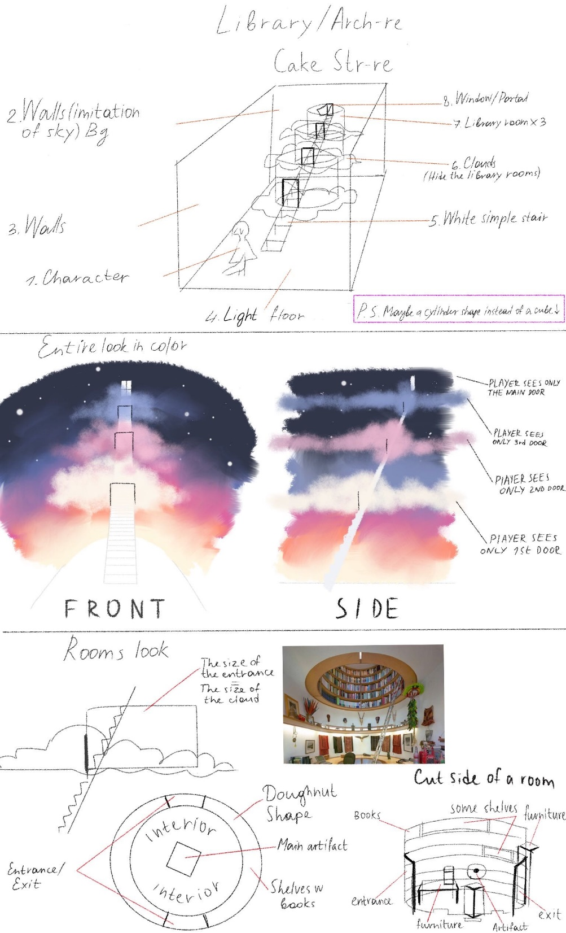
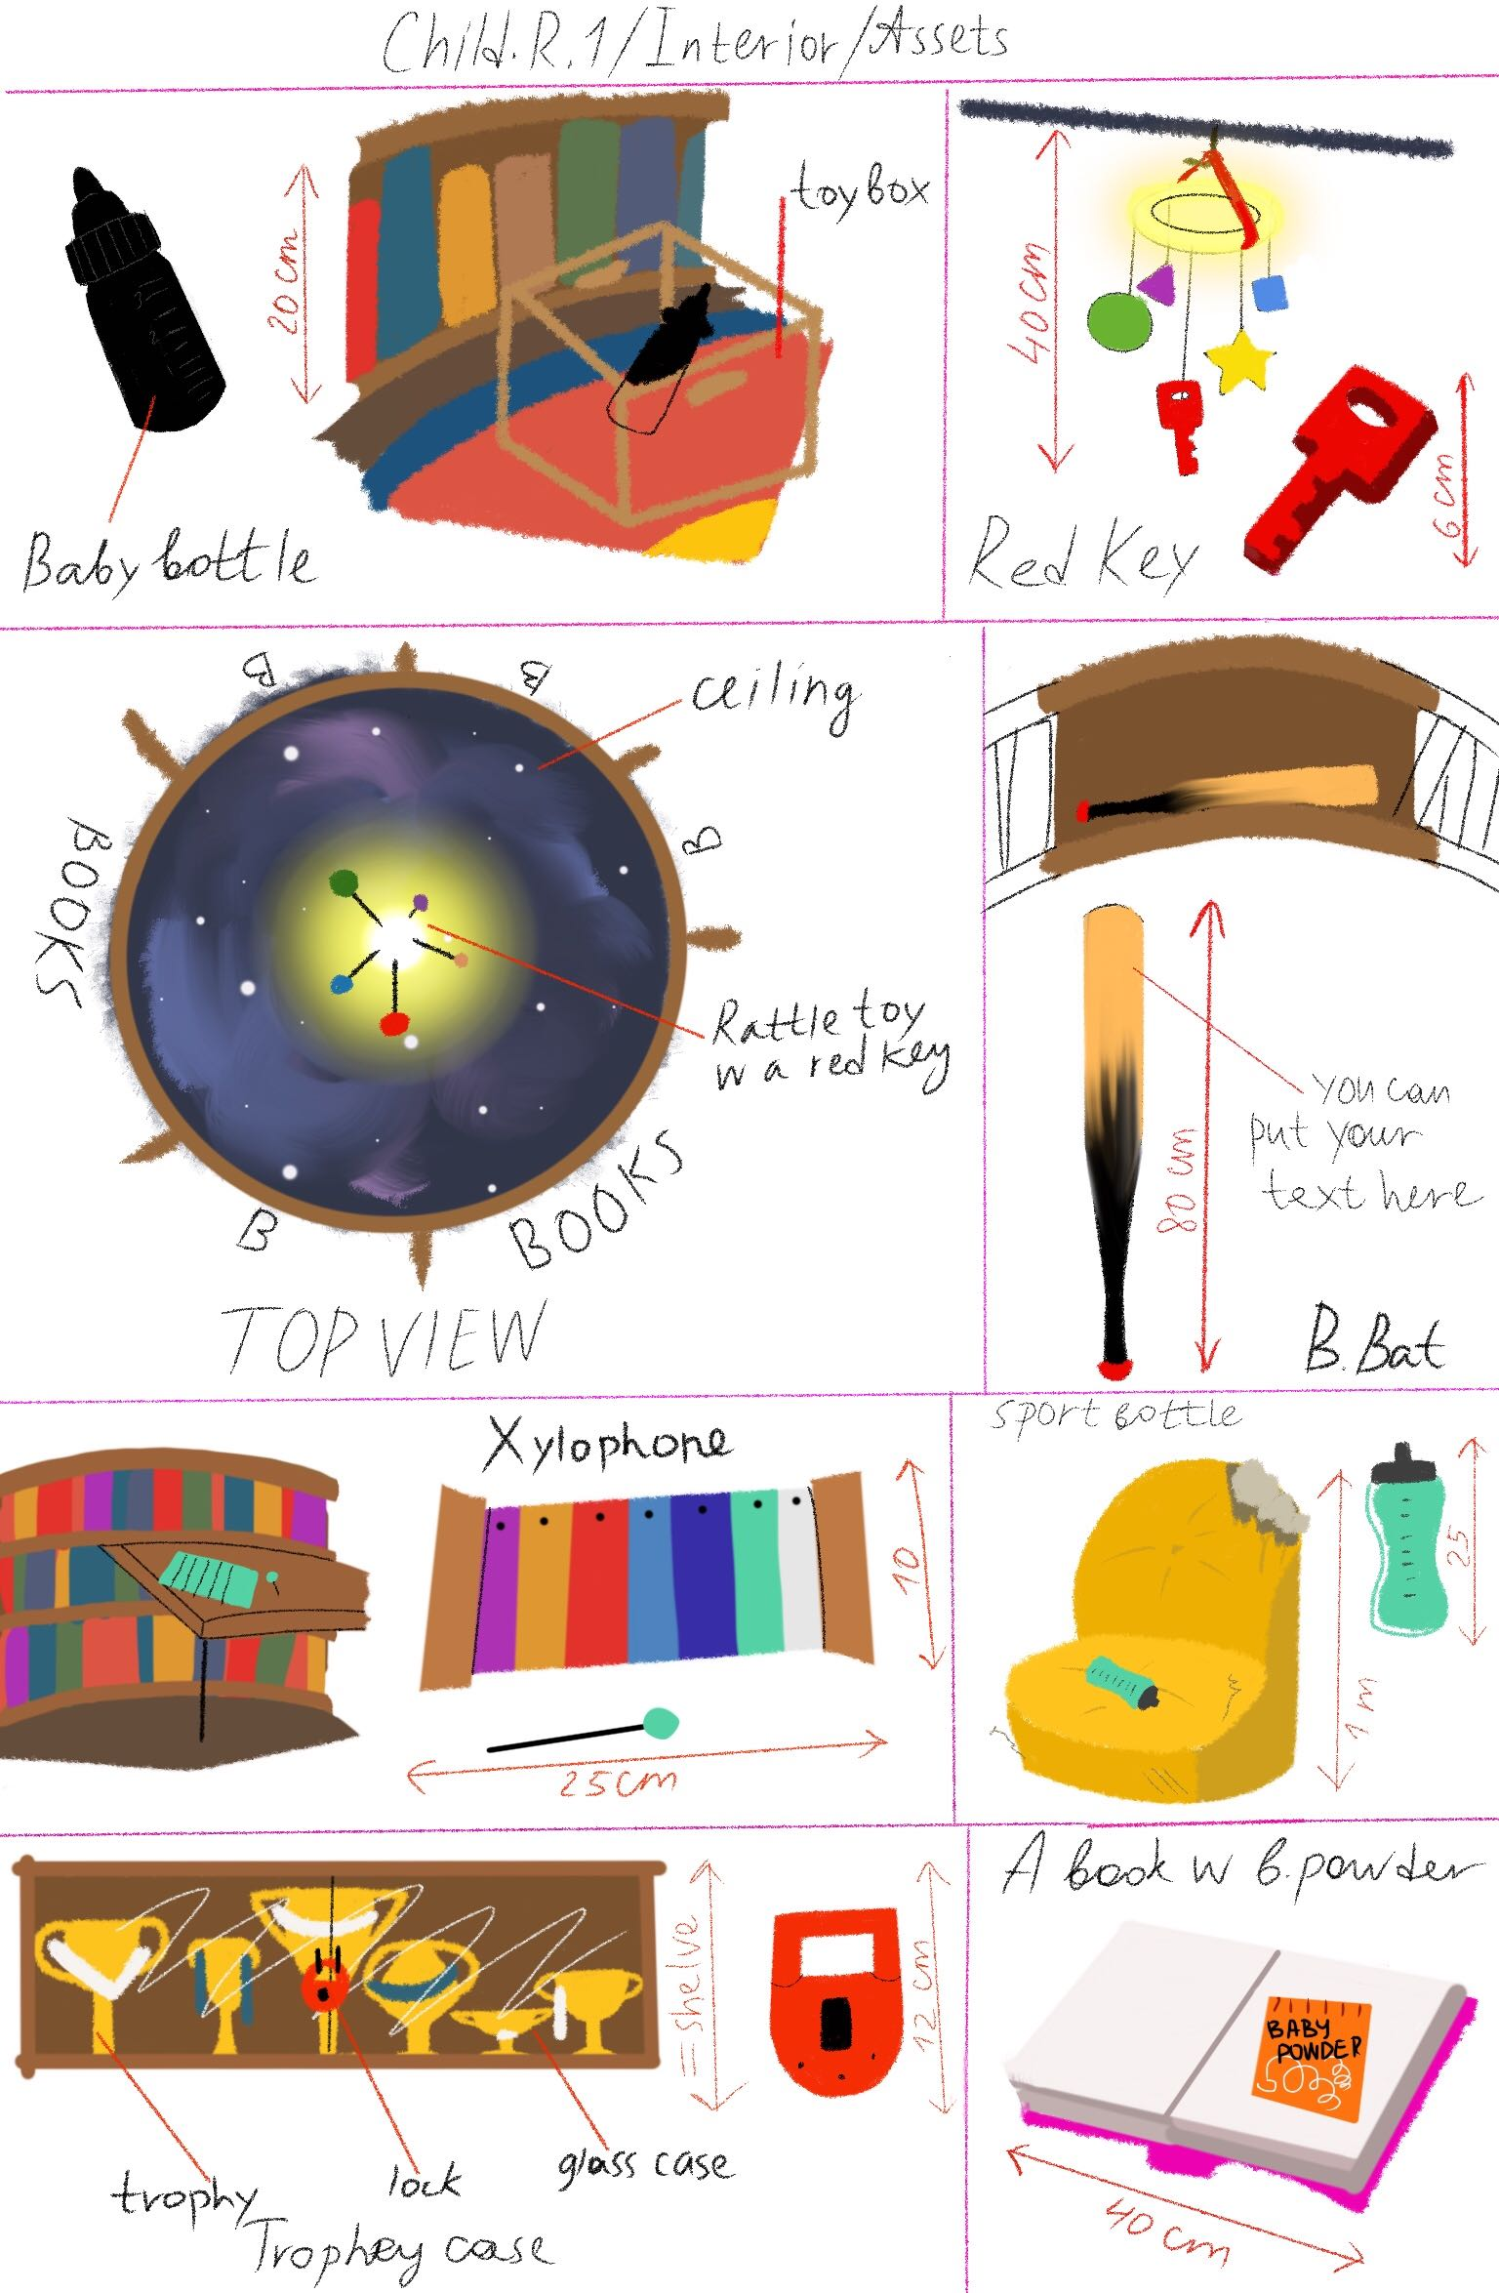
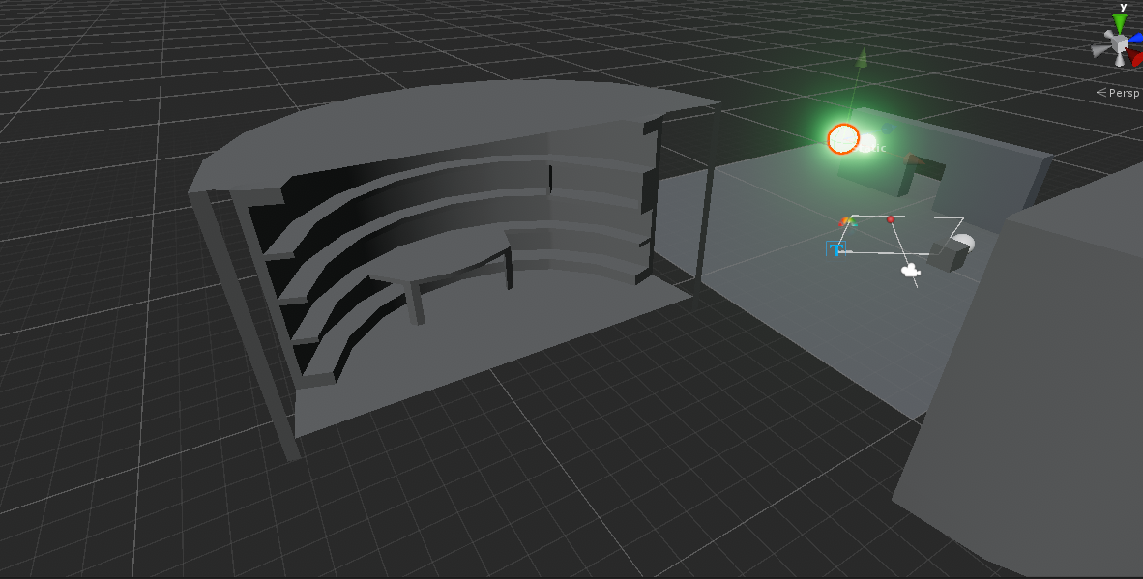
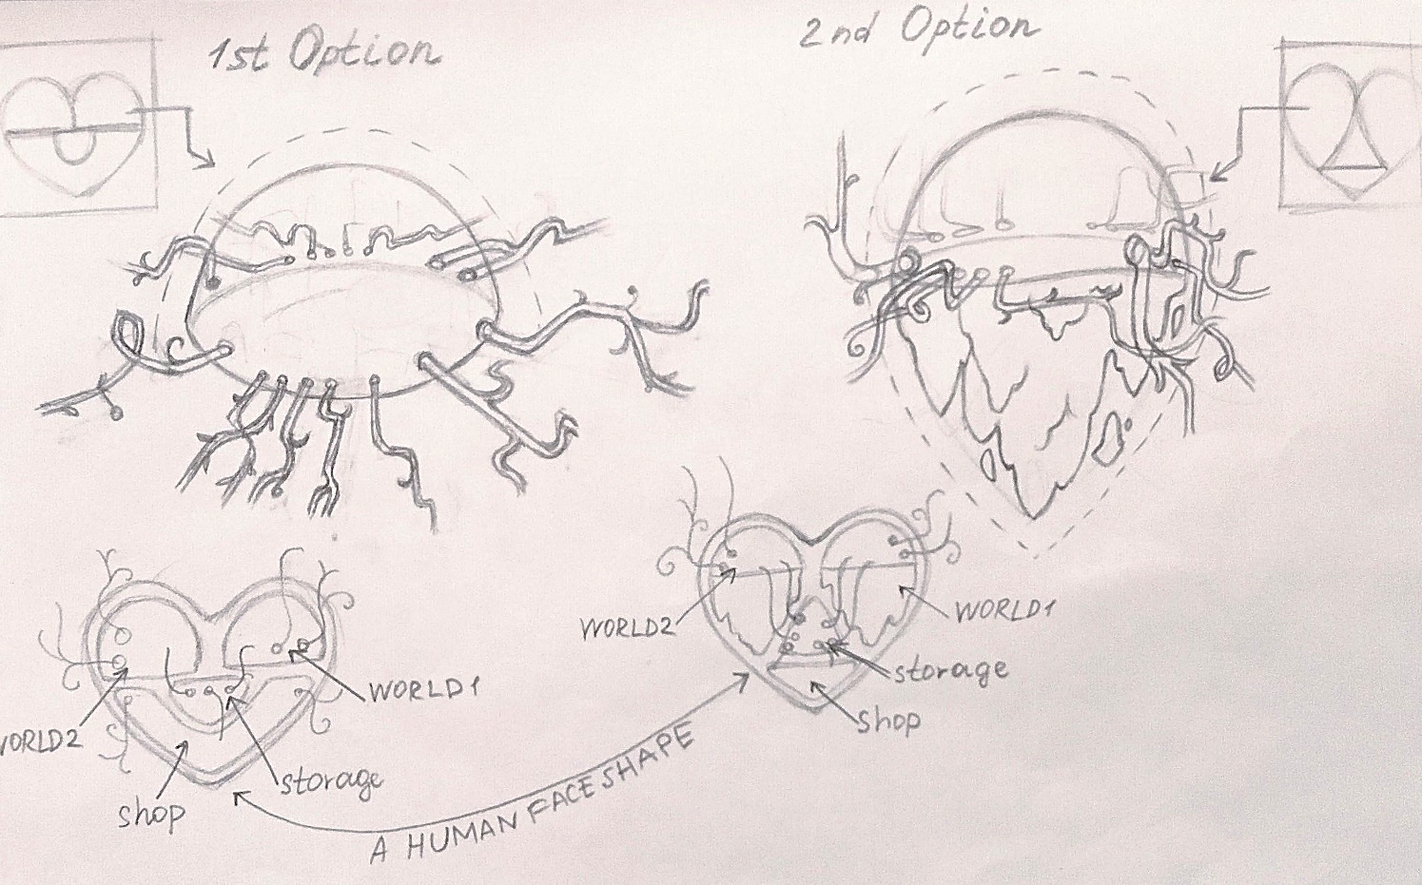
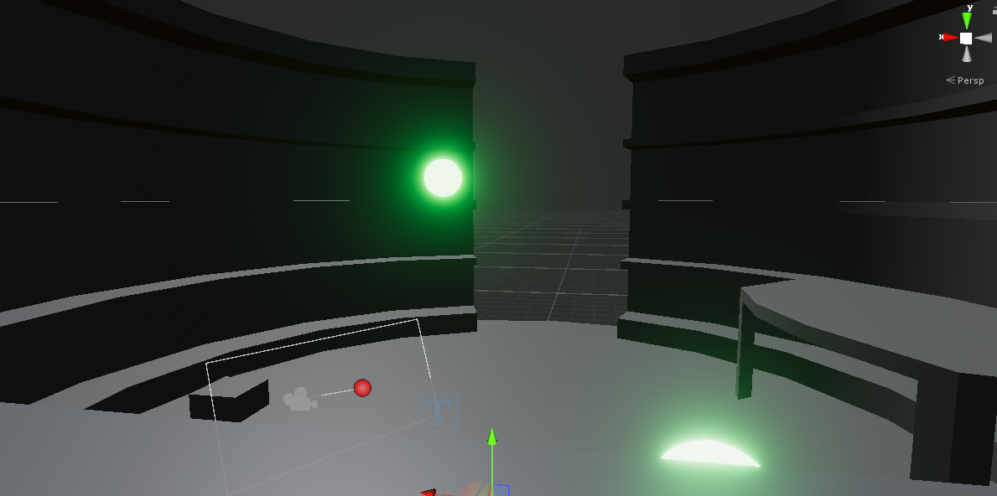

M
Childhood Room Assets
1st Room Rough Model
E
Mood Exploration
Letter Room Concept
Sections of The Heart
D
F
C
B
~ Environment Concept Art~
Maria
A
G

Slide 11
PROGRAMMING
- Demo -

Slide 13
PLANNING & EXECUTION

Slide 14



* basic structure based on
presentations
= main objectives
*cluster of assets
* accessibility of most recent game build
* weekly ~sprints~
= small objectives
* quick feedback
* knowledge of what everyone is working on at all times
* lists of assets, mechanics, animations, sounds etc.
* summary of game ideas
* all resources available
* personal deadlines

Slide 15
THANK YOU FOR LISTENING
Collaborative project. Narrative Game. ST_2019

